Slide 1
COMP6115 Object Oriented Analysis and Design Session #7

Slide 2
Moving on to Design

Slide 3
Learning Outcomes
LO1: Identify the basic concept of advance topic in
Object Oriented Analysis and Design
LO2 : Use the knowledge to develop documentation
for object oriented software analysis and
design using Unified Modelling Language
LO3 : Analyze any problem in any software
application and find out the alternative
solutions using object oriented analysis and
design approach

Slide 4
Chapter 7: Moving on to Design

Slide 5
Learning Objectives
Verifying and Validating the Analysis Models
Balancing between Functional, Structural, Behavioral Models
Evolving the Analysis Models into Design Models
Packages and Package Diagrams
Design Strategies: Custom Development, Packaged Software, Outsourcing
Selecting an Acquisition Strategy

Slide 6
Introduction
Analysis determines the business needs
Design activities focus on how to build the system
Major activity is to evolve the models into a design
Goal is to create a blueprint for the design that makes sense to implement
Determine how and where data will be stored
Determine how the user will interface with the system (user interface, inputs and outputs)
Decide on the physical architecture
Analysis and design phases are highly interrelated and may require much “going back and forth”
Example: prototyping may uncover additional information

Slide 7
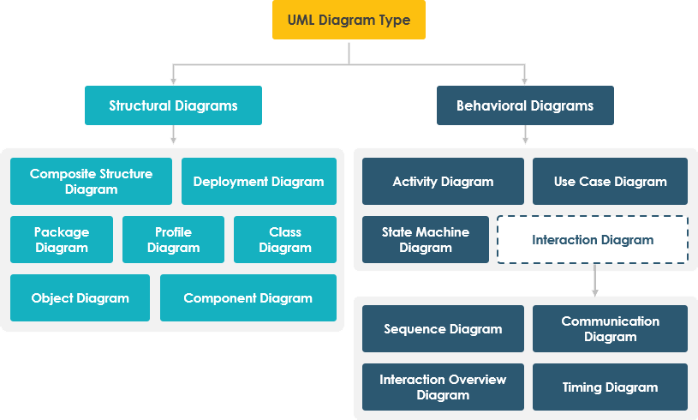
UML Diagram Types
Structural diagrams show the things in the modeled system. In a more technical term, they show different objects in a system.
Behavioral diagrams describe the internal behavior of a system. They describe how the objects interact with each other to create a functioning system.

Slide 8
Verifying and Validating the Analysis Models

Slide 9
The Design Process
Verify and validate the analysis models
Evolve the analysis models into design models
Create packages and utilize package diagrams
Decide upon a design strategy

Slide 10
Verifying & Validating the Analysis Models
Do the analysis models accurately represent the problem domain?
Test the consistency and relationship of each model
Example: Activity Diagrams, Use-Case Descriptions, and Use-Case Diagrams should all describe the same functional requirements
Balance the models to ensure consistency between them

Slide 11
Balancing between Functional, Structural, Behavioral Models

Slide 12
Balancing Functional & Structural Models
To balance the functional and structural models, we must ensure that the two sets of models are consistent with each other.
Activity Diagrams
Use Case Descriptions
Use case Diagrams
CRC Cards
Class Diagrams
represent the
evolving model of the problem domain

Slide 13
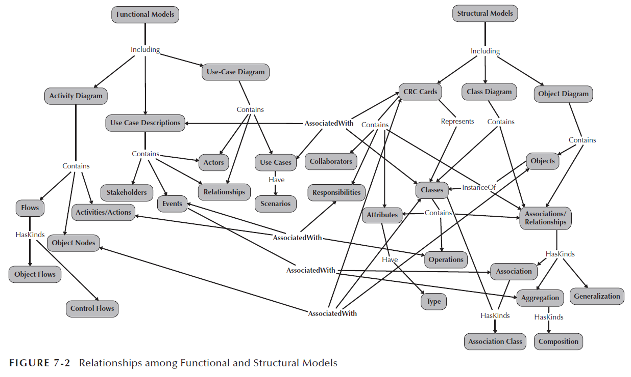
To balance the functional and structural models, we must ensure that the two sets of models are consistent with each other.

Slide 14
Balancing Functional & Structural Models
Every class on a class diagram and every CRC card must be associated with at least one use-case, and vice versa.
Every activity in an activity diagram and every event in a use-case description should be related to one or more responsibilities on a CRC card and one or more operations in a class on a class diagram and vice versa.
Every object node on an activity diagram must be associated with an instance of a class on a class diagram (i.e., an object) and a CRC card or an attribute contained in a class and on a CRC card.
Every attribute and association/aggregation relationships contained on a CRC card (and connected to a class on a class diagram) should be related to the subject or object of an event in a use-case description.

Slide 15
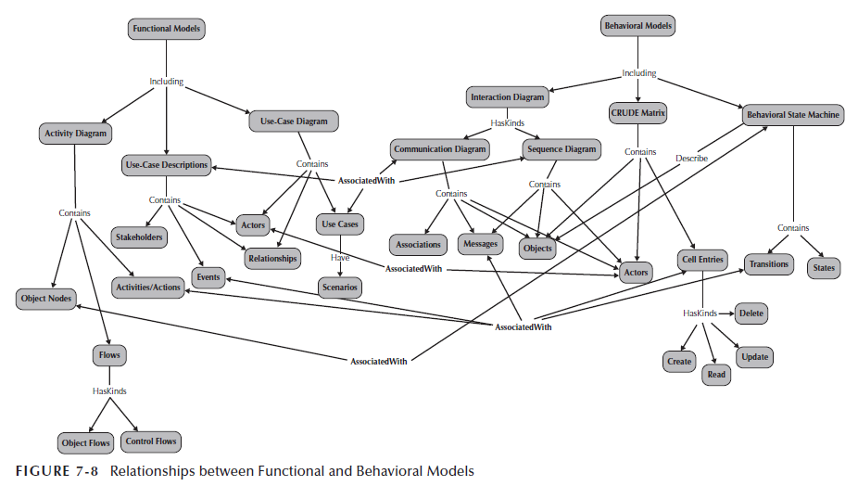
As in balancing the functional and structural models, we must ensure the consistency of the two sets of models.

Slide 16
Balancing Functional & Behavioral Models
The sequence and communication diagrams must be associated with a use case on the use-case diagram and a use-case description.
Actors on sequence diagrams, communication diagrams, and/or CRUDE matrices must be associated with actors on the use-case diagram or referenced in the use-case description, and vice versa.
Messages on sequence and communication diagrams, transitions on behavioral state machines, and entries in a CRUDE matrix must be related to activities and actions on an activity diagram and events listed in a use-case description, and vice versa.
All complex objects represented by an object node in an activity diagram must have a behavioral state machine that represents the object’s lifecycle, and vice versa.

Slide 17
Balancing Structural & Behavioral Models (cont.)
Objects that appear in a CRUDE matrix must be associated with classes that are represented by CRC cards and appear on the class diagram, and vice versa.
Because behavioral state machines represent the life cycle of complex objects, they must be associated with instances (objects) of classes on a class diagram and with a CRC card that represents the class of the instance.
Communication and sequence diagrams contain objects that must be an instantiation of a class that is represented by a CRC card and is located on a class diagram.
Messages contained on the sequence and communication diagrams, transitions on behavioral state machines, and cell entries on a CRUDE matrix must be associated with responsibilities and associations on CRC cards and operations in classes and associations connected to the classes on class diagrams.
The states in a behavioral state machine must be associated with different values of an attribute or set of attributes that describe an object.

Slide 18
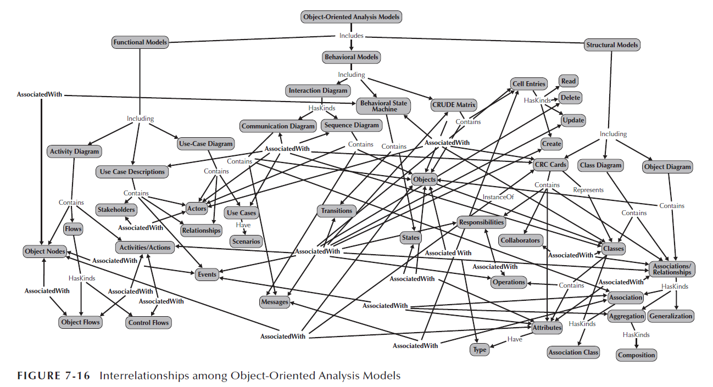
Summary

Slide 19
Evolving the Analysis Models into Design Models

Slide 20
Evolving the Analysis Models into Design Models
Now that we have successfully verified and validated our analysis models, we need to begin evolving them into appropriate design models.
Analysis models focused on functional requirements
Design models must include non-functional requirements as well
System performance
System environment issues
Distributed vs. centralized processing
User interface
Database
The system must be maintainable and affordable, efficient and effective
Utilize factoring, partitions & collaborations, and layers

Slide 21
Factoring
Factoring is the process of separating out a module into a stand-alone module.
Creating modules that account for similarities and differences between units of interest
New classes formed through a:
Generalization (a-kind-of) relationship, or a
Aggregation (has-parts) relationship
Abstraction—create a higher level class (e.g., create an Employee class from a set of job positions)
Refinement—create a detailed class (e.g., create a secretary or bookkeeper from the Employee class)

Slide 22
Generalization (a-kind-of) Relationship
Employee
Nurse
Receptionist
Doctor

Slide 23
Partitions and Collaborations
A partition is the object-oriented equivalent of a subsystem, where a subsystem is a decomposition of a larger system into its component systems
e.g., an accounting information system could be functionally decomposed into an accounts-payable system, an accounts-receivable system, a payroll system, etc.
Partition: create a sub-system of closely collaborating classes
Base partitions on patterns of activity (e.g., collaborations found in a communication diagram)
Greater coupling among classes may identify partitions (e.g., more messages passes between objects suggests that they belong in the same partition)
Identifying partitions and collaborations determines which classes should be grouped together

Slide 24
Partitions and Collaborations
For example, if attributes of a class have complex object types, such as Person, Address, or Department, and these object types were not modeled as associations in the class diagram, we need to recognize these implied associations.
Department
x y z
Employee
Person Address Department

Slide 25
Layers
Until this point in the development of our system, we have focused only on the problem domain; we have totally ignored the system environment (data management, user interface, and physical architecture).
System environment information must now be added
Use layers to represent and separate elements of the software architecture
A layer represents an element of the soft ware architecture of the evolving system.
Easier to understand a complex system
Example:
Model-view-controller (MVC) architecture
Separates application logic from user interface
Proposed layers:
Foundation (e.g., container classes)
Problem domain (e.g., encapsulation, inheritance, polymorphism)
Data management (e.g., data storage and retrieval)
User interface (e.g., data input forms)
Physical architecture (e.g., specific computers and networks)

Slide 26
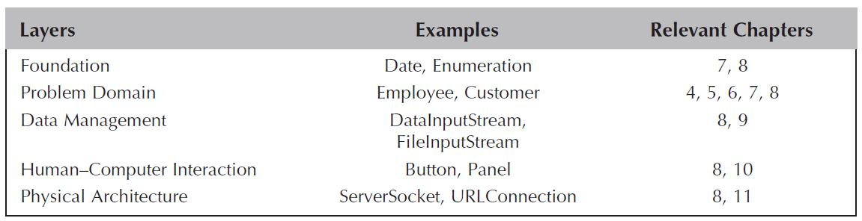
Layers

Slide 27
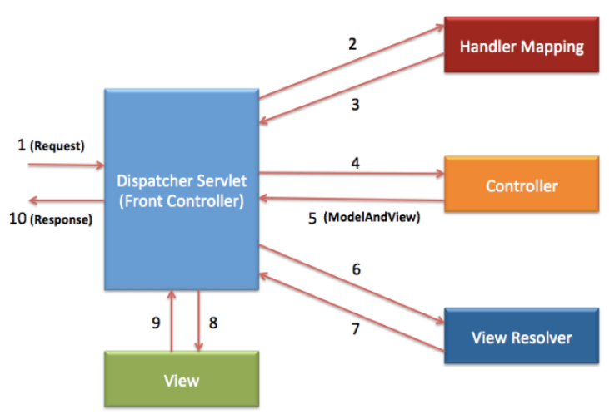
Layers
The idea of separating the different elements of the architecture into separate layers can be traced back to the MVC architecture of Smalltalk¹.
Spring MVC Framework Example
¹See S. Lewis, Th e Art and Science of Smalltalk: An Introduction to Object-Oriented Programming Using Visual-Works (Englewood Cliff s, NJ: Prentice Hall, 1995).

Slide 28
Packages and Package Diagrams

Slide 29
Packages and Package Diagrams
In UML, collaborations, partitions, and layers can be represented by a higher-level construct: a package.
Packages group together similar components (e.g., use-cases, class diagrams)
Package diagrams show the packages and their relationships
Aggregation & association relationships are possible
Packages may be dependent upon one another
If one package is modified, others that depend on it may also require modification

Slide 30
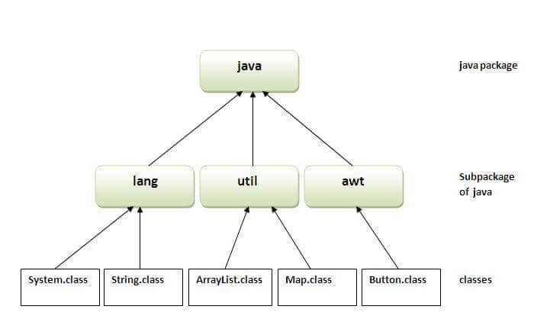
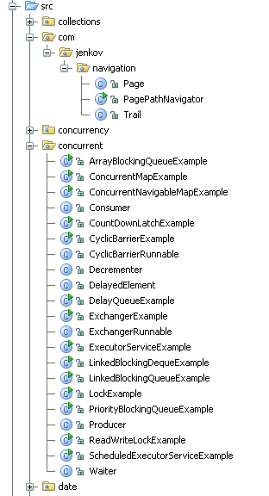
Java Package Examples

Slide 31
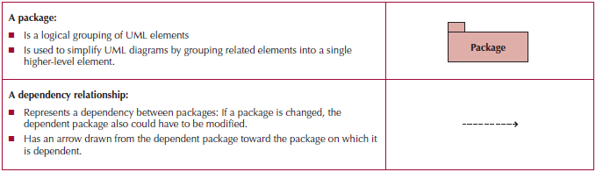
Package
A general construct that groups units together
Used to reduce complexity of models
A package diagram shows packages only

Slide 32
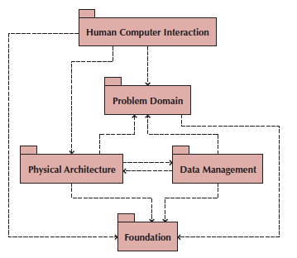
Package Diagram of Dependency Relationships among Layers

Slide 33
Guidelines for Building Package Diagrams
Use package diagrams to logically organize designs.
Specifically, use packages to group classes together when there is an inheritance, aggregation, or composition relationship between them or when the classes form a collaboration.
In some cases, inheritance, aggregation, or association relationships exist between packages.
In those cases, for readability purposes, try to support inheritance relationships vertically, with the package containing the superclass being placed above the package containing the subclass.
Use horizontal placement to support aggregation and association relationships, with the packages being placed side by side.
When a dependency relationship exists on a diagram, it implies that there is at least one semantic relationship between elements of the two packages.
The direction of the dependency is typically from the subclass to the superclass, from the whole to the part, and with contracts, from the client to the server.
In other words, a subclass is dependent on the existence of a superclass, a whole is dependent upon its parts existing, and a client can’t send a message to a nonexistent server.

Slide 34
Guidelines for Building Package Diagrams
When using packages to group use cases together, be sure to include the actors and the associations that they have with the use cases grouped in the package.
This will allow the diagram’s user to better understand the context of the diagram.
Give each package a simple, but descriptive name to provide the package diagram user with enough information to understand what the package encapsulates.
Otherwise, the user will have to drill-down or open up the package to understand the package’s purpose.
Be sure that packages are cohesive.
For a package to be cohesive, the classes contained in the package, in some sense, belong together. A simple, but not perfect, rule to follow when grouping classes together in a package is that the more the classes depend on each other, the more likely they belong together in a package.

Slide 35
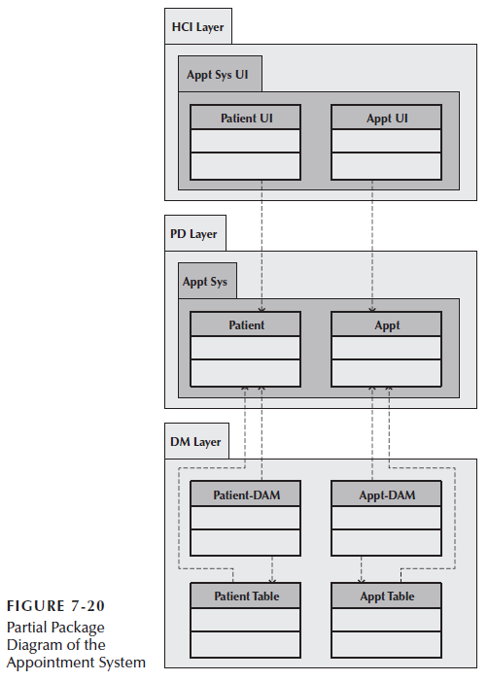

Slide 36
Guidelines for Building Package Diagrams
Use them to logically organize your design
Observe semantic relationships
Vertical positioning indicates inheritance
Horizontal positioning indicates aggregation and association
Dependency relationships should also observe semantic relationships
For use-case package diagrams, include the actors
Use simple but descriptive names for each package
Make packages cohesive

Slide 37
Building Package Diagrams
Set the context
Cluster classes together based on shared relationships
Create packages from the clusters
Identify dependency relationships among packages
Lay out and draw the diagram including only the packages and their dependencies
The first step is to set the context for the package diagram.
The second step is to cluster the classes together into partitions based on the relationships that the classes share.
The third step is to place the clustered classes together in a partition and model the partitions as packages.
The fourth step is to identify the dependency relationships among the packages.
The fifth step is to lay out and draw the diagram.

Slide 38
Design Strategies: Custom Development, Packaged Software, Outsourcing

Slide 39
Design Strategies
Many project teams assume that custom development, or building a new system from scratch, is the best way to create a system.
➔ requires dedicated eff ort that involves long hours and hard work.
Alternatives:
Purchase packaged software
Office suites (e.g., word processors, spreadsheets, etc.)
Enterprise systems (e.g., SAP, PeopleSoft)
Hire an external vendor (outsource)

Slide 40
Custom Development
Allows for meeting highly specialized requirements
Allows flexibility and creativity in solving problems
Easier to change components
Builds personnel skills
May excessively burden the IT staff
May add significant risk

Slide 41
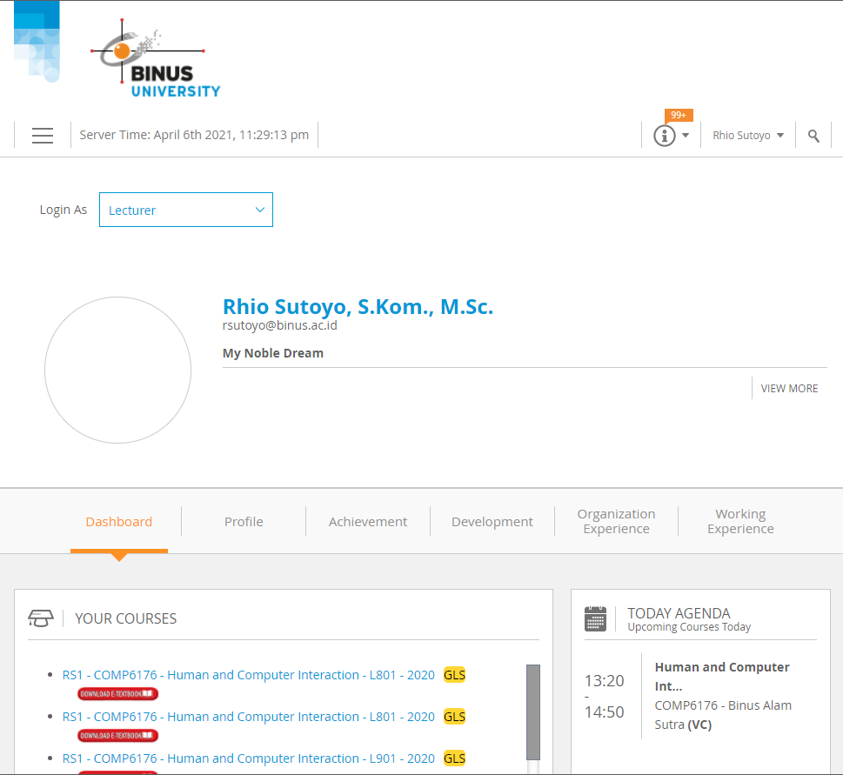
Custom Development

Slide 42
Packaged Software
Software already written (e.g., accounting software)
May be more efficient
May be more thoroughly tested and proven
May range from components to tools to entire enterprise systems
Must accept functionality provided
May require change in how the firm does business
May require significant “customization” or “workarounds”

Slide 43
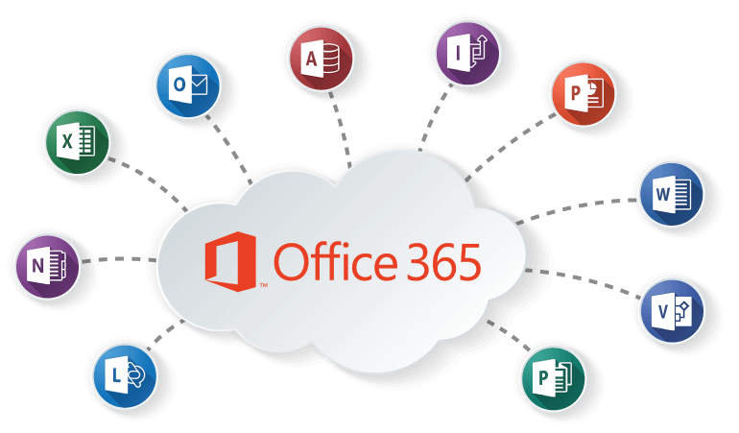
Packaged Software

Slide 44
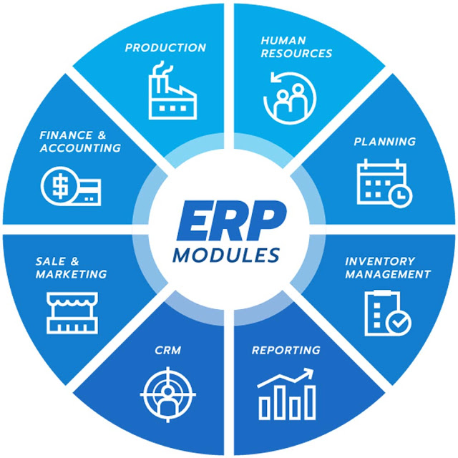
Packaged Software

Slide 45
System Integration
Building a new system by combining packages, legacy systems, and new software
Not uncommon to purchase off the shelf software and outsource its integration to existing systems
Key challenge is integrating data
May require data transformations
New package may need to write data in the same format as a legacy system
Develop “object wrappers”
Wraps the legacy system with an API to allow newer systems to communicate with it
Protects the investment in the legacy system

Slide 46



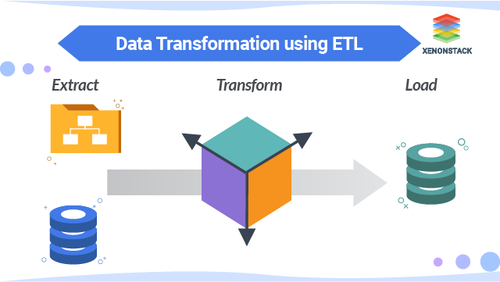
Human Capital
Operations
Marketing

Slide 47
Outsourcing
Hire an external firm to create the system
Requires extensive two-way coordination, information exchange and trust
Disadvantages include loss of control, compromise confidential information, transfer of expertise
Carefully choose your vendor
Carefully prepare the contract and method of payment
Contract types:
Time-and-arrangement: pay for all time and expenses
Fixed-price: pay an agreed upon price
Value-added: pay a percentage of benefits

Slide 48
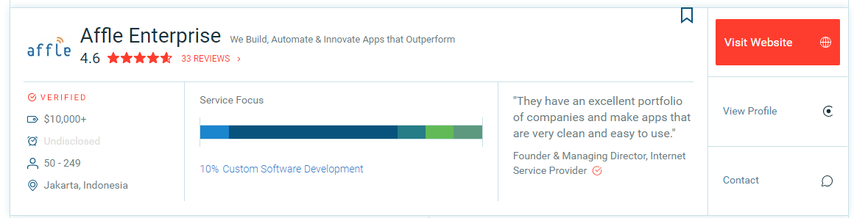
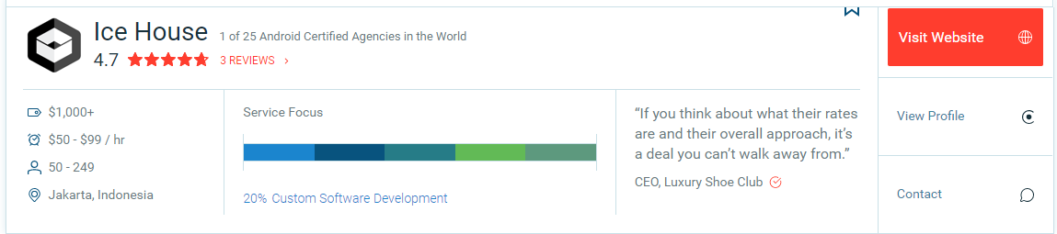
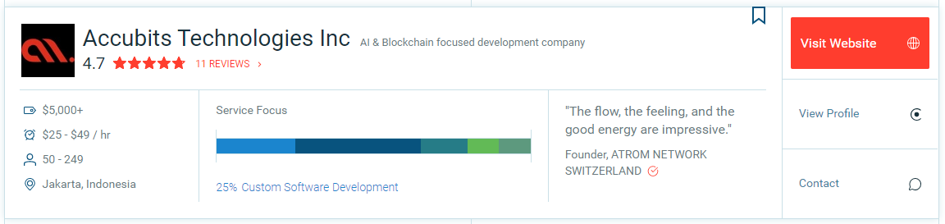

Slide 49
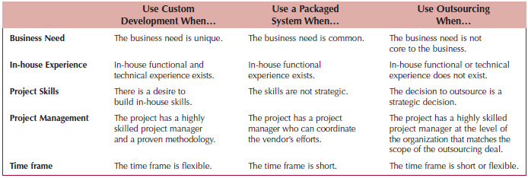
Selecting a Design Strategy

Slide 50
Selecting an Acquisition Strategy

Slide 51
SELECTING AN ACQUISITION STRATEGY
Determine tools and skills needed for in-house development
Identify existing packages that satisfy the users’ needs
Locate companies who can build it under contract
Create an alternative matrix to organize the pros and cons of each possible choice
Incorporate technical, economic and organizational feasibility
Utilize an RFP or RFI to obtain cost & time estimates from potential vendors

Slide 52
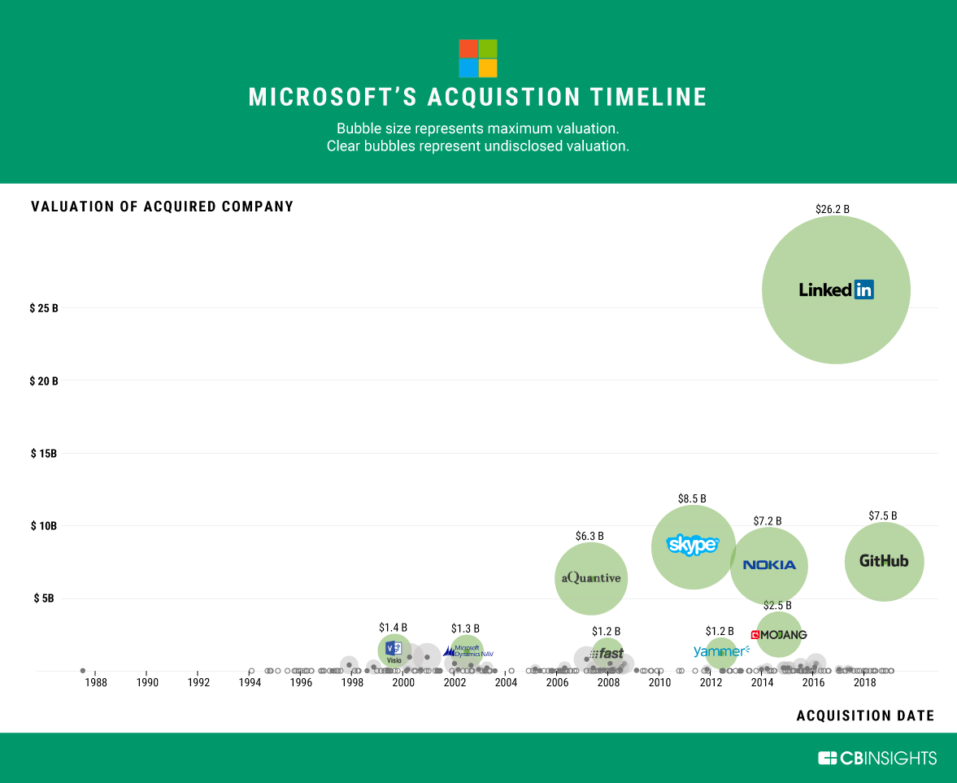

Slide 53
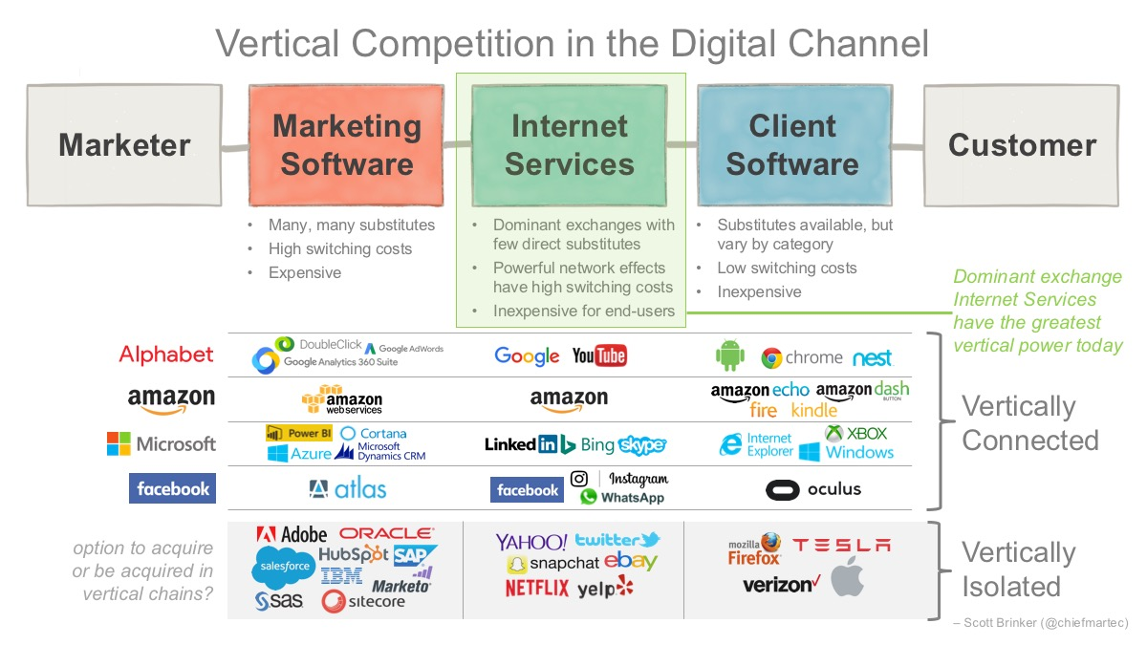

Slide 54
Summary

Slide 55
Summary
Verifying and Validating the Analysis Models
Evolving the Analysis Models into Design Models
Packages and Package Diagrams
Design Strategies
Developing the Actual Design

Slide 56
References
Denis, Wixom,Tegarden. (2015). Systems Analysis and Design: An Object-Oriented Approach with UML. 5th edition. ISBN: 978-1-118-80467-4, John Wiley & Sons, Inc, Denver (USA)

